Slide 1


Slide 2
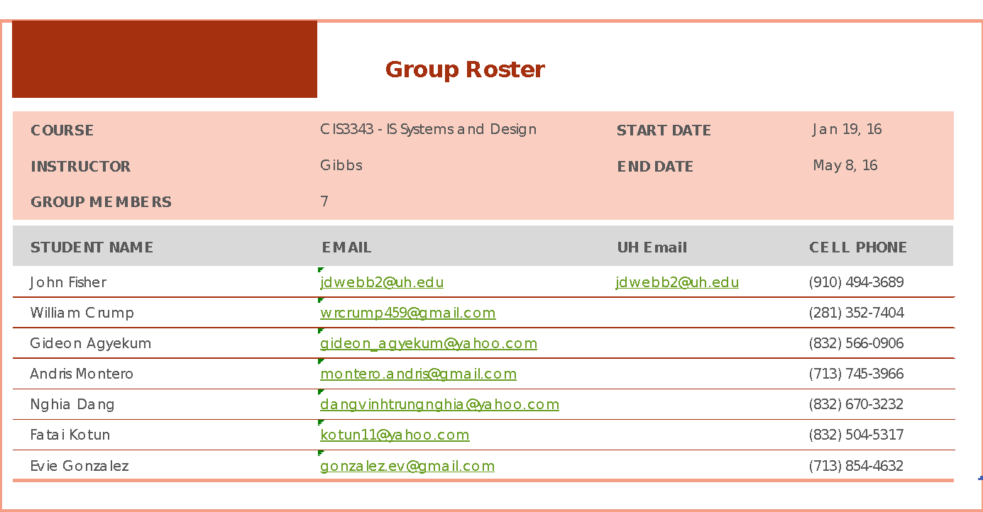
Red Ninja Developers

Slide 3
Presentation Outline

Slide 4
Security O.F.F.I.C.E.R.S.
Security
Officer
Form
Filing
Interface and
Centralized
Employee
Register
Software

Slide 5

Client
We are highly trained individuals that have prior military, corrections, police, and security experience. They are men and women with a common goal- to provide the finest services to their clients.
“Boutique” Security for Commercial Clients
Focused on Customer Service and Attention to Detail
Currently 10-15 employees
2 Current Contracts, Kirby Grove and Baytown Ford
Notes:
Hand off to Fisher

Slide 6
Organizational Chart
Strategic
Dean Cooper, Owner
Middle Mgmt
Kevin Morgan
Supervisor
Operational
Day Officer
Night Officer
Weekend Officer
Notes:
Hand off to Fatai

Slide 7
Timeline
Texas Department of Corrections 2002-2005
Director of Security, United Protection Services 2011-2015
Metro Police Officer 2005-2011
Started Trident Security Professionals 2015-Present

Slide 8
Current System
Client currently use a monthly paid app
Take features that the client want and combine them
It is a web based application
The application provide GPS tracking
Required 4G or WIFI
Application does not require user to have high computer skill to operate
Able to be use on smart phone
Application provide login accounts for supervisor on property, officer work on property and customers
Officer use application to perform clock-in and clock-out
Officer use application to file Daily Activity Report every half an hour or whenever they perform some task
Officer use application to file Incident Report whenever something out of ordinary occur
Supervisor use application to monitor officer during their shift and do payroll
Supervisor use application to edit Daily Activity Report from officers
Customer use application to read Daily Activity Report from officers
Notes:
Hand off to Dang

Slide 9

System Problems
Required 4G or WIFI
Remote place cause officer unable to use application
No scheduling feature
No official time stamp
Supervisor have to use GPS tracking to see what time officer get on site
Cause supervisor more problem to do payroll correctly
Some location cannot be tracked by GPS
Loss of data when closing browser
Cannot manage a server
Some employees do not want to use application
System down:
Officer cannot update their status
Supervisors cannot manage their officer which lead to problems with their customers

Slide 10
Objectives
Organization Objective list
Configure current system to where information on officers and reports written by them can be accessed easier.
Improve company to customer relations through means of communication
Systems objective list
Implement a real-time scheduling aspect so supervisors can see when and where certain officers are on duty and when events happen, while also aiding with payroll.
Make system and reports accessible, even in remote locations.
Make data retrievable, even when browser is closed.
Notes:
Hand off to Gideon

Slide 11
Objectives
User Objective List
Employee (Officer)
Use system to perform clock-in/out service
Use system to formulate daily reports
Use system to file incidents
Supervisor
Use system to check whereabouts of officers
Use system to monitor clock-in/out times of officers
Use system to formulate employee payroll
Use system to check employee reports
Customer
Use system to check employee reports
Use system to verify time worked by officer
Notes:
Hand off to Gideon

Slide 12
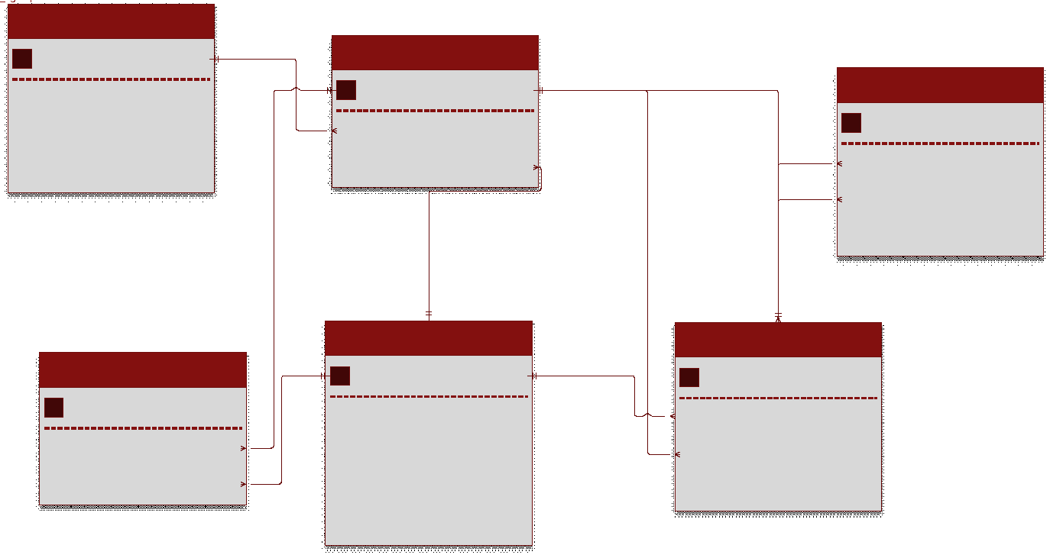
Logical Data Model

Slide 13
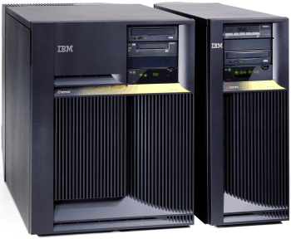
System Proposals
Systems Proposal One
Physical Server
Advantages
Complete control over the system design
Disadvantages
Need to hire an IT person in order to keep up with day to day maintenance such as patch updates
Cannot implement cheaper database language. Will need to use an enterprise version of MySQL
Equipment and code maintenance
Cost
Equipment: $1,000
MySQL Enterprise: $5,000
Devices
Microsoft phones and tablets
Programming Language
.NET Development
Notes:
Hand off to Evie

Slide 14

System Proposals
Systems Proposal Two
Google Cloud Platform
Advantages
Fast and modern service
No need for physical equipment on the premises
Users MySQL coding language compatible with Java
Will not need a round the clock IT Support
Disadvantages
Application support can cost at least $1,800 a year, but it not necessary
Cost
Services and storage: $1,500 per year
Devices
Android phones and tablets
Programming Language
Java
Notes:
Hand off to Evie

Slide 15
Testing Plan
Introduction:
This is the plan for testing the database we create for Trident Security Professionals. Security O.F.F.I.C.E.R.S. is the system we plan on building for them
The purpose of this test plan is to:
Summarize the entire test approach
Identify the steps required in our database test
Define Deliverables
Scope:
We have identified that the following items are critical to the success of Security O.F.F.I.C.E.R.S.:
Data Integrity and accuracy for the system in general
Ensuring that data is being stored on the employee’s device
Timestamp accuracy

Slide 16
Testing Plan
Test Approach:
Data Integrity
Send lots of test data to our database. Once sent, compare data on database to the test data sent and check for discrepancies.
Employee Device Data Storage
Set up multiple devices that sends data forms to our database and manually record what data is being sent. After data is sent, compare the manually recorded data to the received database data and check for discrepancies. Also make sure the device also keeps record of what is being sent.
Timestamp Accuracy
We will test this manually by sending fake Clock In data and recording the times manually. We will then compare the times that the Timestamp software gives us to our manually recorded data to check for discrepancies.
Test Environment:
Test will be conducted using our currently owned equipment and test data.
Deliverables:
The test will produce the following deliverables:
Data Integrity Report
Employee Data Integrity Report
Timestamp Accuracy Report
Risks:
There is almost no risk because we will be using test data for all of our tests.

Slide 17
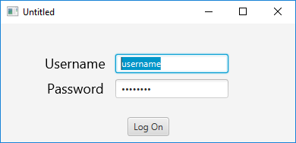
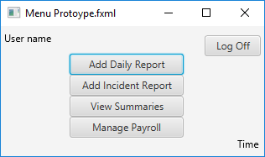
Login / Main Menu
Prototype

Slide 18
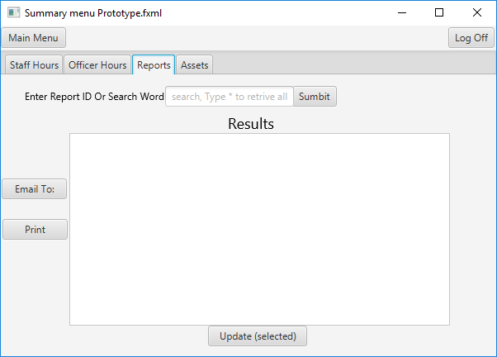
Summary Menu (Report Tab)
Prototype

Slide 19
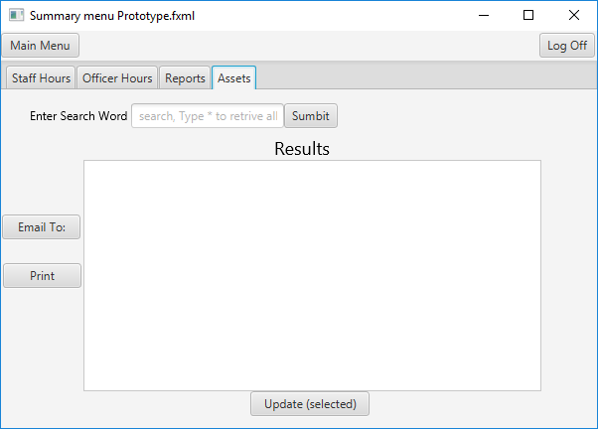
Summary Menu (Assets Tab)
Prototype

Slide 20
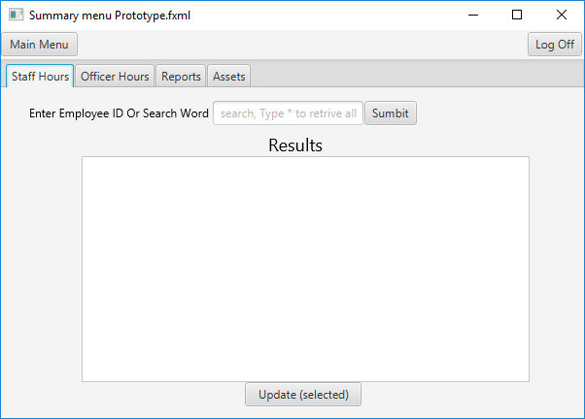
Summary Menu (Staff Hours Tab)
Prototype

Slide 21
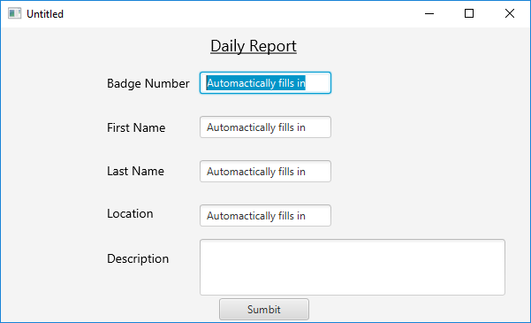
Daily Report Window
Prototype

Slide 22
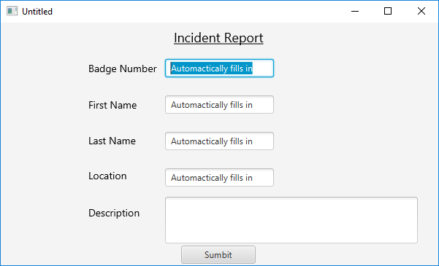
Incident Report Window
Prototype

Slide 23

RND

